Slide 1
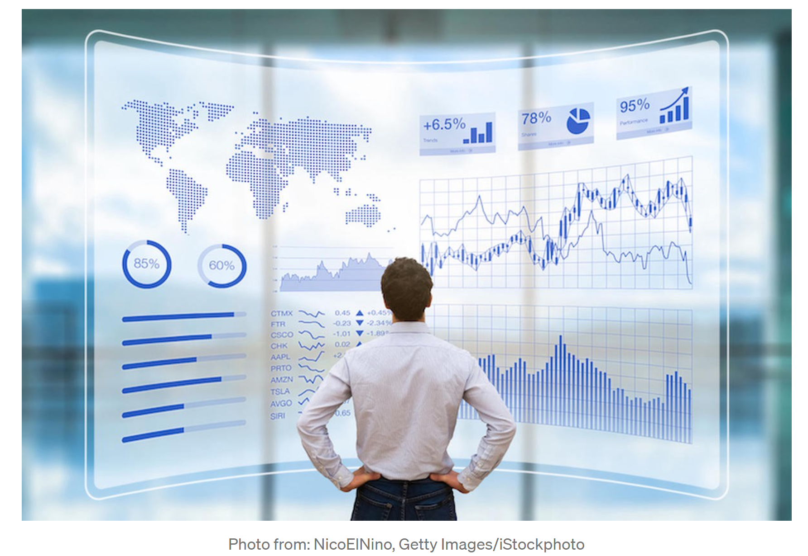
Data Visualization and Acquisition.

Slide 2

B.S. Physics
MS. Physics
Ph.D. Physics (biophysics and statistical distribution)
Certified in Data Science
Post doctoral: Network analysis
Interest: data integration, machine learning and dynamical networks
Mihaela Sardiu

Slide 3
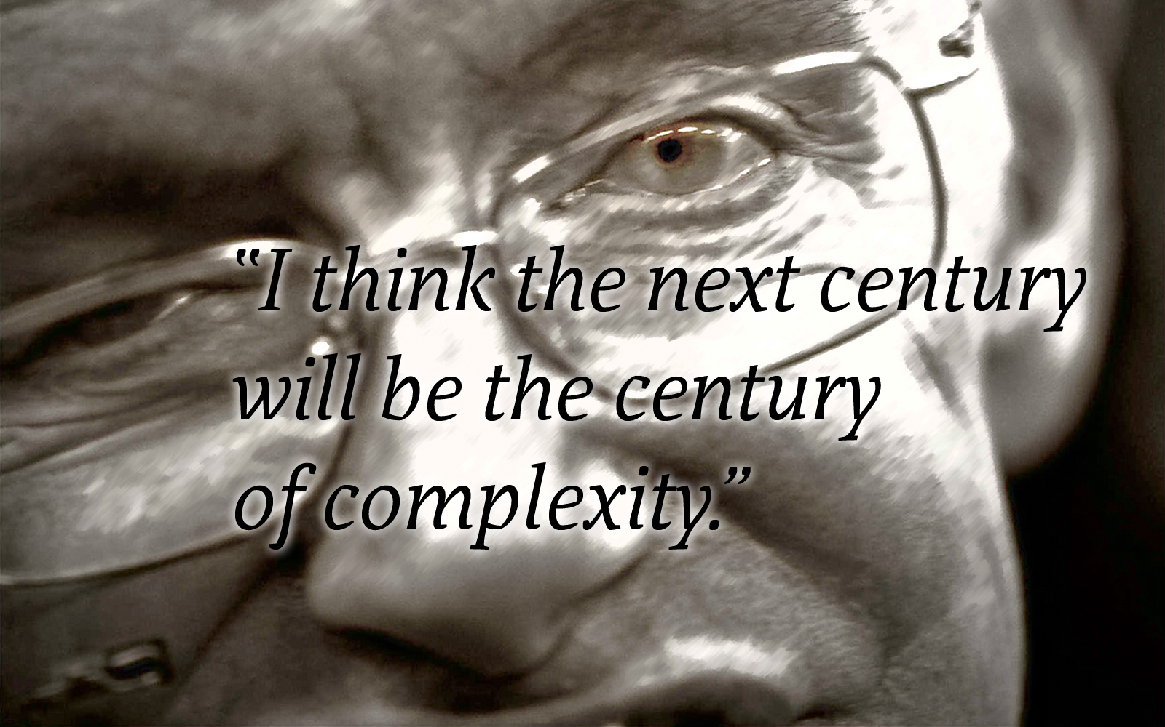
Stephen Hawking
January 23, 2000`

Slide 4


Slide 5
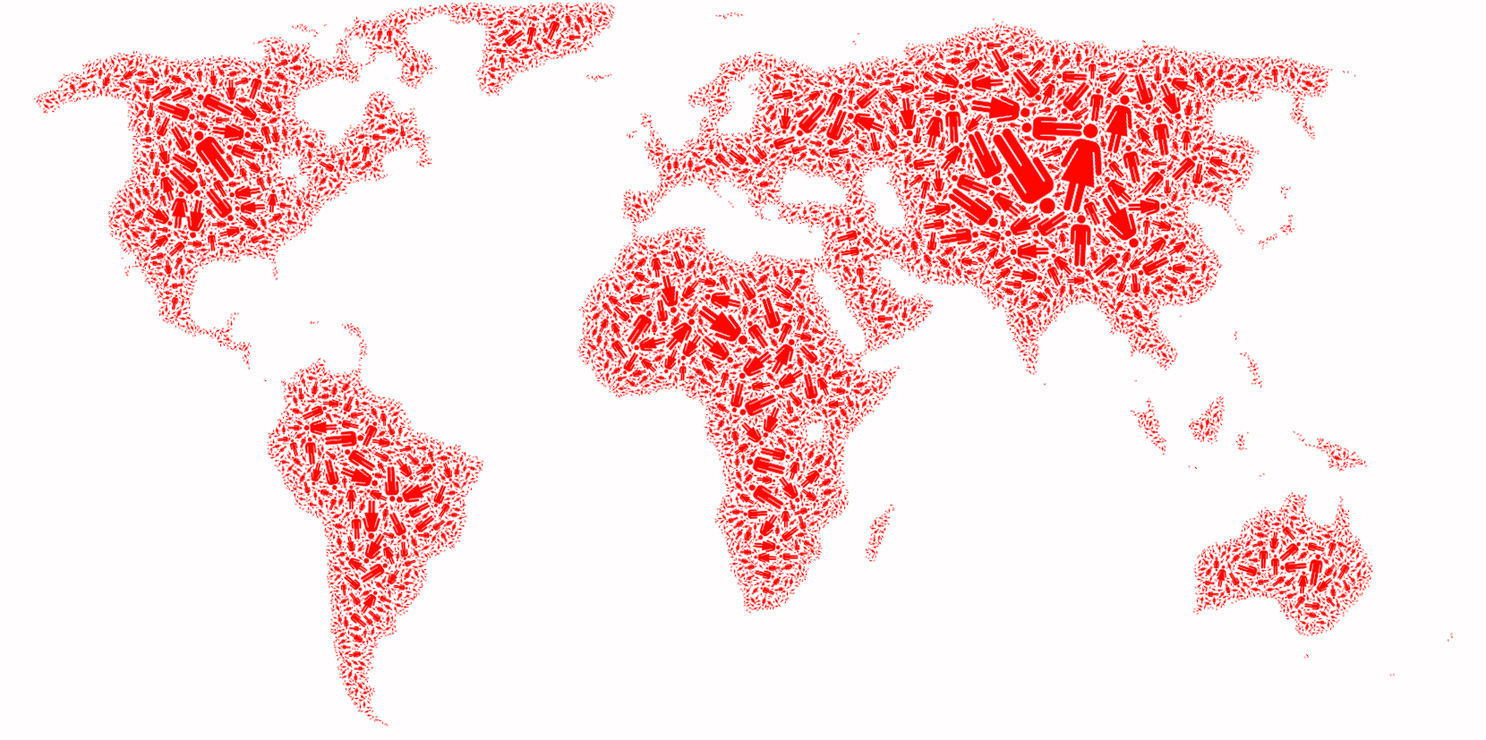
SOCIETY Factoid: Society which is a collection of 7 billion individuals
The "Day of 7 Billion" has been targeted by the United States Census Bureau to be in July 2012.
http://en.wikipedia.org/wiki/World_population
Notes:
5

Slide 6
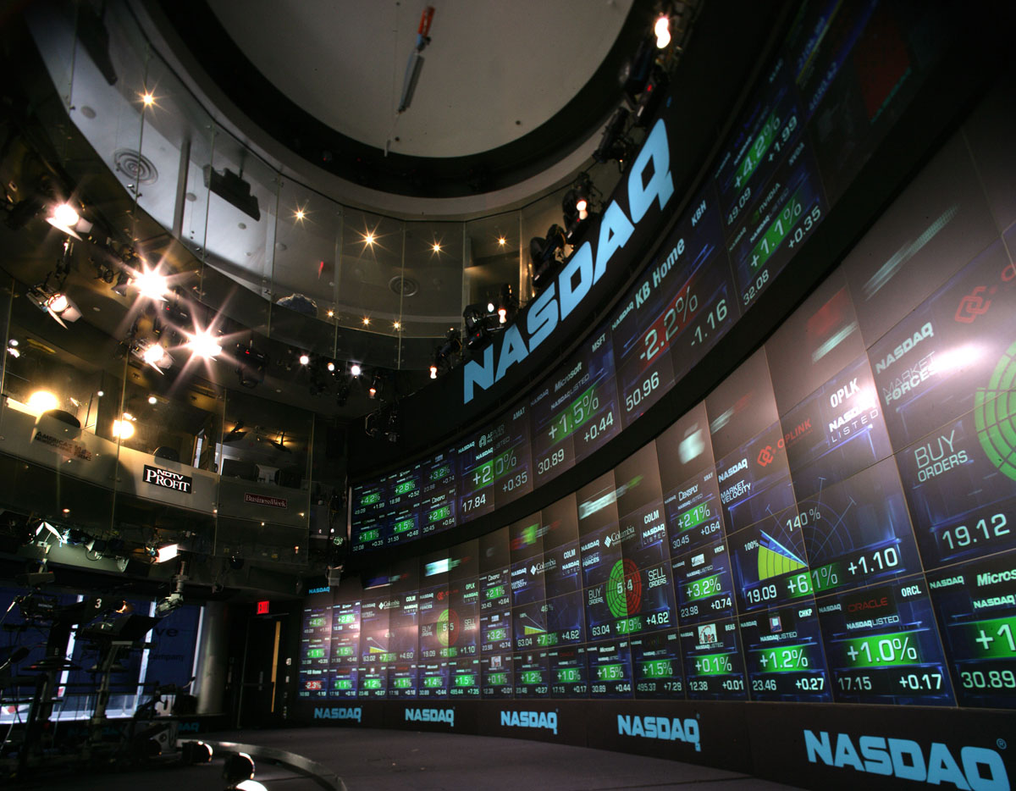
ECONOMY Factoid:
The world economy produced goods and services worth almost $55 trillion in 2005.
(http://siteresources.worldbank.org/ICPINT/Resources/ICPreportprelim.pdf)
To communication systems that links billion of devices, from computer to cell phones.
http://scotttaylor.eu/gaining-exposure-to-social-media/
Notes:
We are surrounded by systems that are hopelessly complex, from the society, a collection of six billion individuals, to communications systems, that these days link billions of devices, from computers to cell phones. Our very existence is rooted in the ability of thousands of genes to work together in a seamless fashion; our thoughts, reasoning, and comprehension of the world is hidden in the connections between billions of neurons in our brain. These systems, random looking at first, upon close inspection display endless signatures of order and self-organization whose quantification, understanding, prediction and eventually control is the major intellectual challenge for the science of the 21st century
6

Slide 7
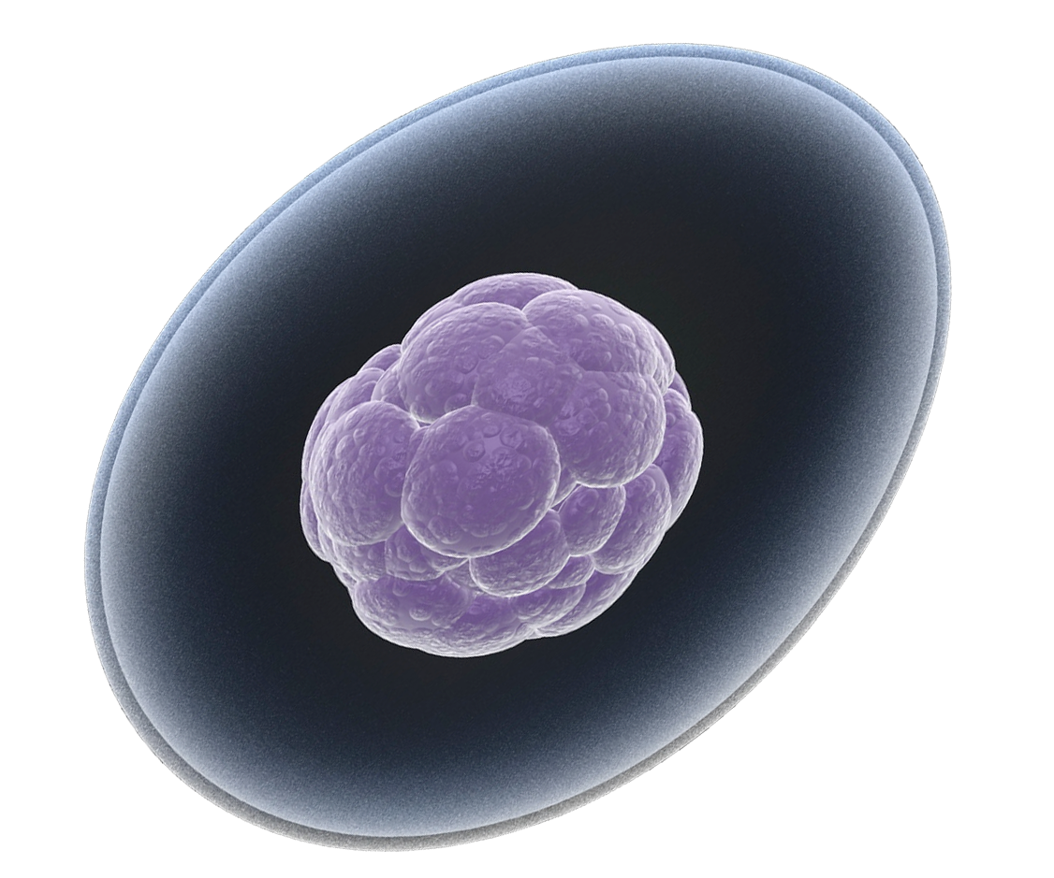
THE HUMAN CELL Factoid:
Our very existence is rooted in the ability of thousand of genes to work together in a seamless
fashion.
How Many Genes are in
the Human Genome?
The Ensemble genome-annotation system
estimates them at:
http://www.ornl.gov/sci/techresources/Human_Genome/faq/genenumber.shtml
23,299
Notes:
We are surrounded by systems that are hopelessly complex, from the society, a collection of six billion individuals, to communications systems, that these days link billions of devices, from computers to cell phones. Our very existence is rooted in the ability of thousands of genes to work together in a seamless fashion; our thoughts, reasoning, and comprehension of the world is hidden in the connections between billions of neurons in our brain. These systems, random looking at first, upon close inspection display endless signatures of order and self-organization whose quantification, understanding, prediction and eventually control is the major intellectual challenge for the science of the 21st century
7

Slide 8
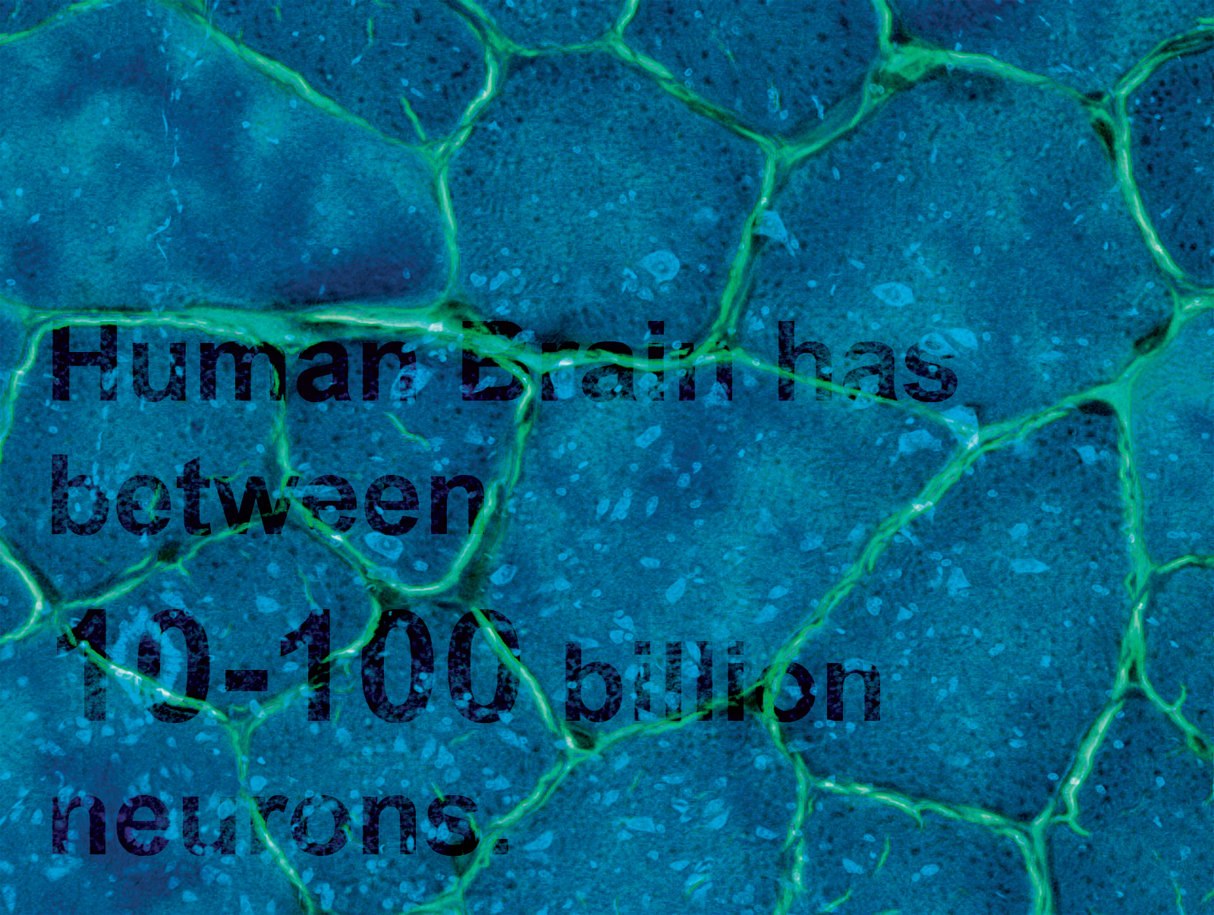
Brain
BRAIN Factoid:
Our thoughts and comprehension of the world is hidden in the connection
between billions of neurons in our brain
Factoid:
Human Brain has between
10-100 billion neurons.
Notes:
We are surrounded by systems that are hopelessly complex, from the society, a collection of six billion individuals, to communications systems, that these days link billions of devices, from computers to cell phones. Our very existence is rooted in the ability of thousands of genes to work together in a seamless fashion; our thoughts, reasoning, and comprehension of the world is hidden in the connections between billions of neurons in our brain. These systems, random looking at first, upon close inspection display endless signatures of order and self-organization whose quantification, understanding, prediction and eventually control is the major intellectual challenge for the science of the 21st century
8

Slide 9


Slide 10
THE EMERGENCE OF Data SCIENCE
Data Availability:
Movie Actor Network, 1998;
World Wide Web, 1999.
C elegans neural wiring diagram 1990
Citation Network, 1998
Metabolic Network, 2000;
PPI network, 2001-2013
Universality:
The architecture of networks emerging in various domains of science, nature, and technology are more similar to each other than one would have expected. These systems random looking at first, upon close inspection display order and self-organization.
The (urgent) need to understand complexity:
Despite the challenges complex systems offer us, we cannot afford to not address their behavior, a view increasingly shared both by scientists and policy makers.
(Source: Albert, Barabasi)

Slide 11
Topics
Data visualization with R (scatter plots, histograms, heatmaps, maps)
Data visualization in Tableu
Databases with SQL
Creating shiny apps and R (web-based interactive data)
Markdowns for interactive visualization
Visualization of data with circos
Data Analysis & Visualization in Cytoscape (static and dynamic
networks)
Project

Slide 12
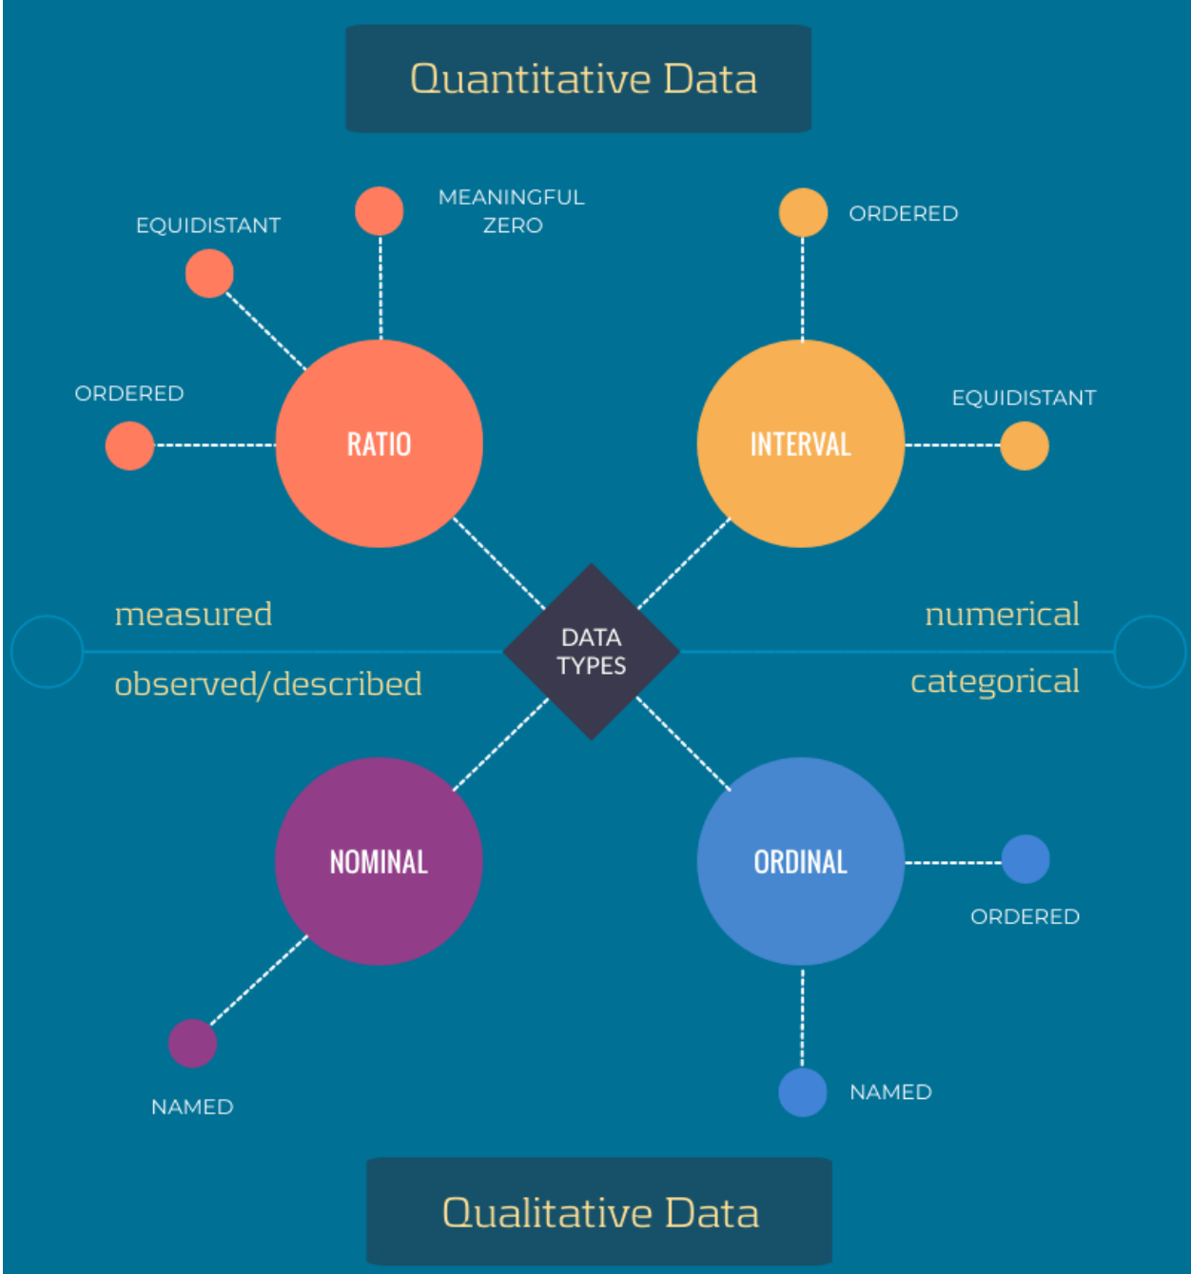
Types of Data in Statistics
https://www.chi2innovations.com/blog/discover-data-blog-series/data-types-101/#t-1605041195701

Slide 13
Types of Data: Measurement Scales
Categorical:
Nominal (name/label)
Ordinal (rank order)
Numerical:
Interval (equal intervals)
Ratio (equal intervals and absolute zero)

Slide 14
Types of Statistical Procedures
Descriptive: Organize and summarize data
Inferential: Draw inferences about the relations between variables; use samples to generalize to population

Slide 15
Descriptive Statistics
The first step is ALWAYS getting to know your data
 Summarize and visualize your data
It is a big mistake to just throw numbers into the computer and look at the output of a statistical test without any idea what those numbers are trying to tell you or without checking if the assumptions for the test are met

Slide 16


Typical data science project:
A good visualization will show you things that you did not expect or raise new questions about the data. A good visualization might also hint that you’re asking the wrong question, or you need to collect different data.
https://r4ds.had.co.nz/introduction.html

Slide 17
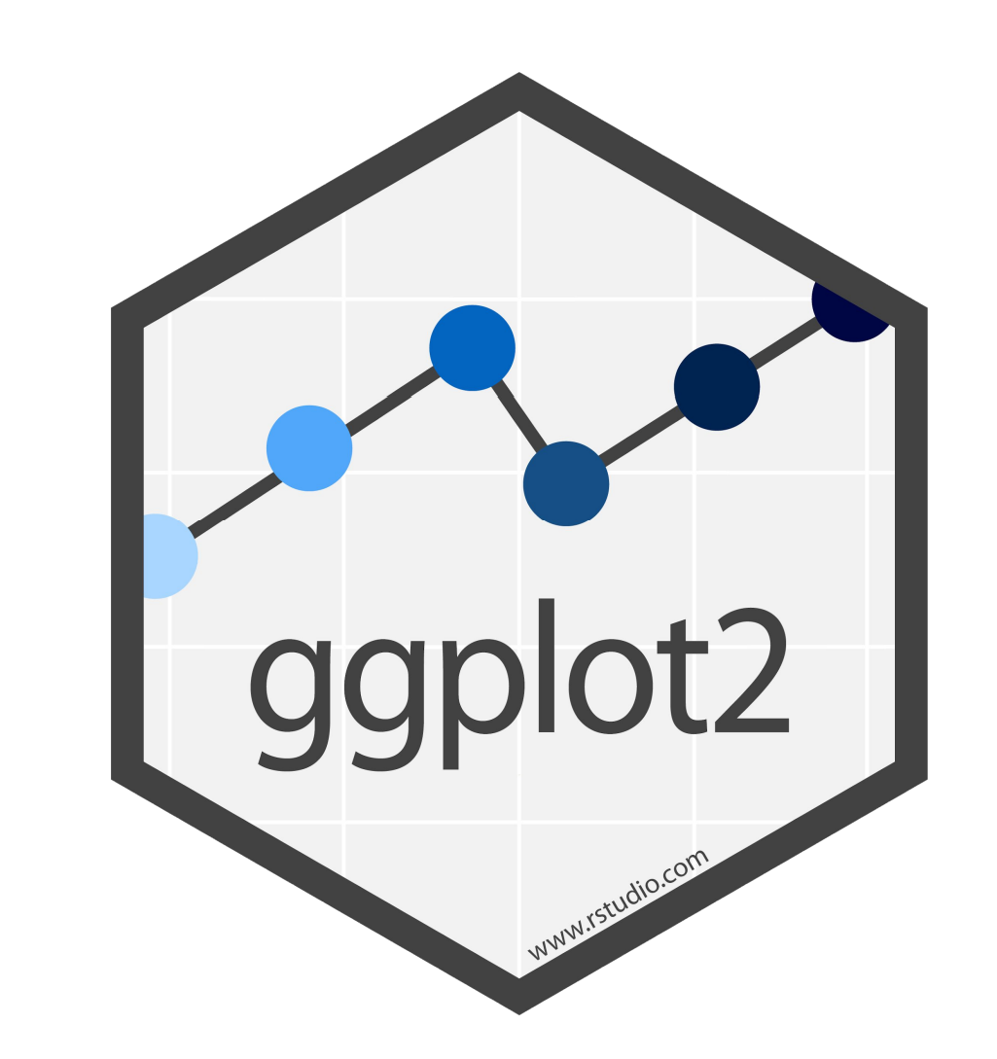
ggplot2 ?
R library created by Hadley Wickham
Primarily available from CRAN and Bioconductor
Also available from GitHub, Bitbucket, Gitorious, etc. (and elsewhere)
Packages from CRAN/Bioconductor can be installed with install.packages()
Packages from GitHub can be installed using install_github() from the devtools package

Slide 18
ggplot2
● R package for creating statistical or data graphics.
● Each figure is made of independent components that can be put together in many different ways.
● These components are presented with layers that are building blocks of each figure.
● Learning how to use ggplot2 demands some time, and the time invested in learning will payoff, especially when you need to visualize your data

Slide 19
ggplot2 foundations
Section overview:
● Grammar of graphics & ggplot2
● Data
● Aesthetics mapping
● Geometries
● Facets
● Statistics
● Coordinates & scales
● Theme
● Export plot

Slide 20
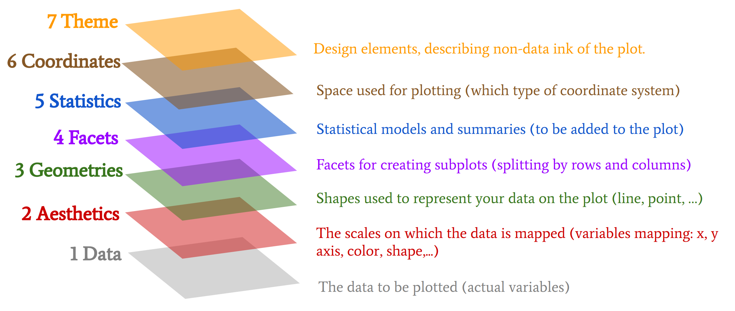
The components of layered graphics

Slide 21
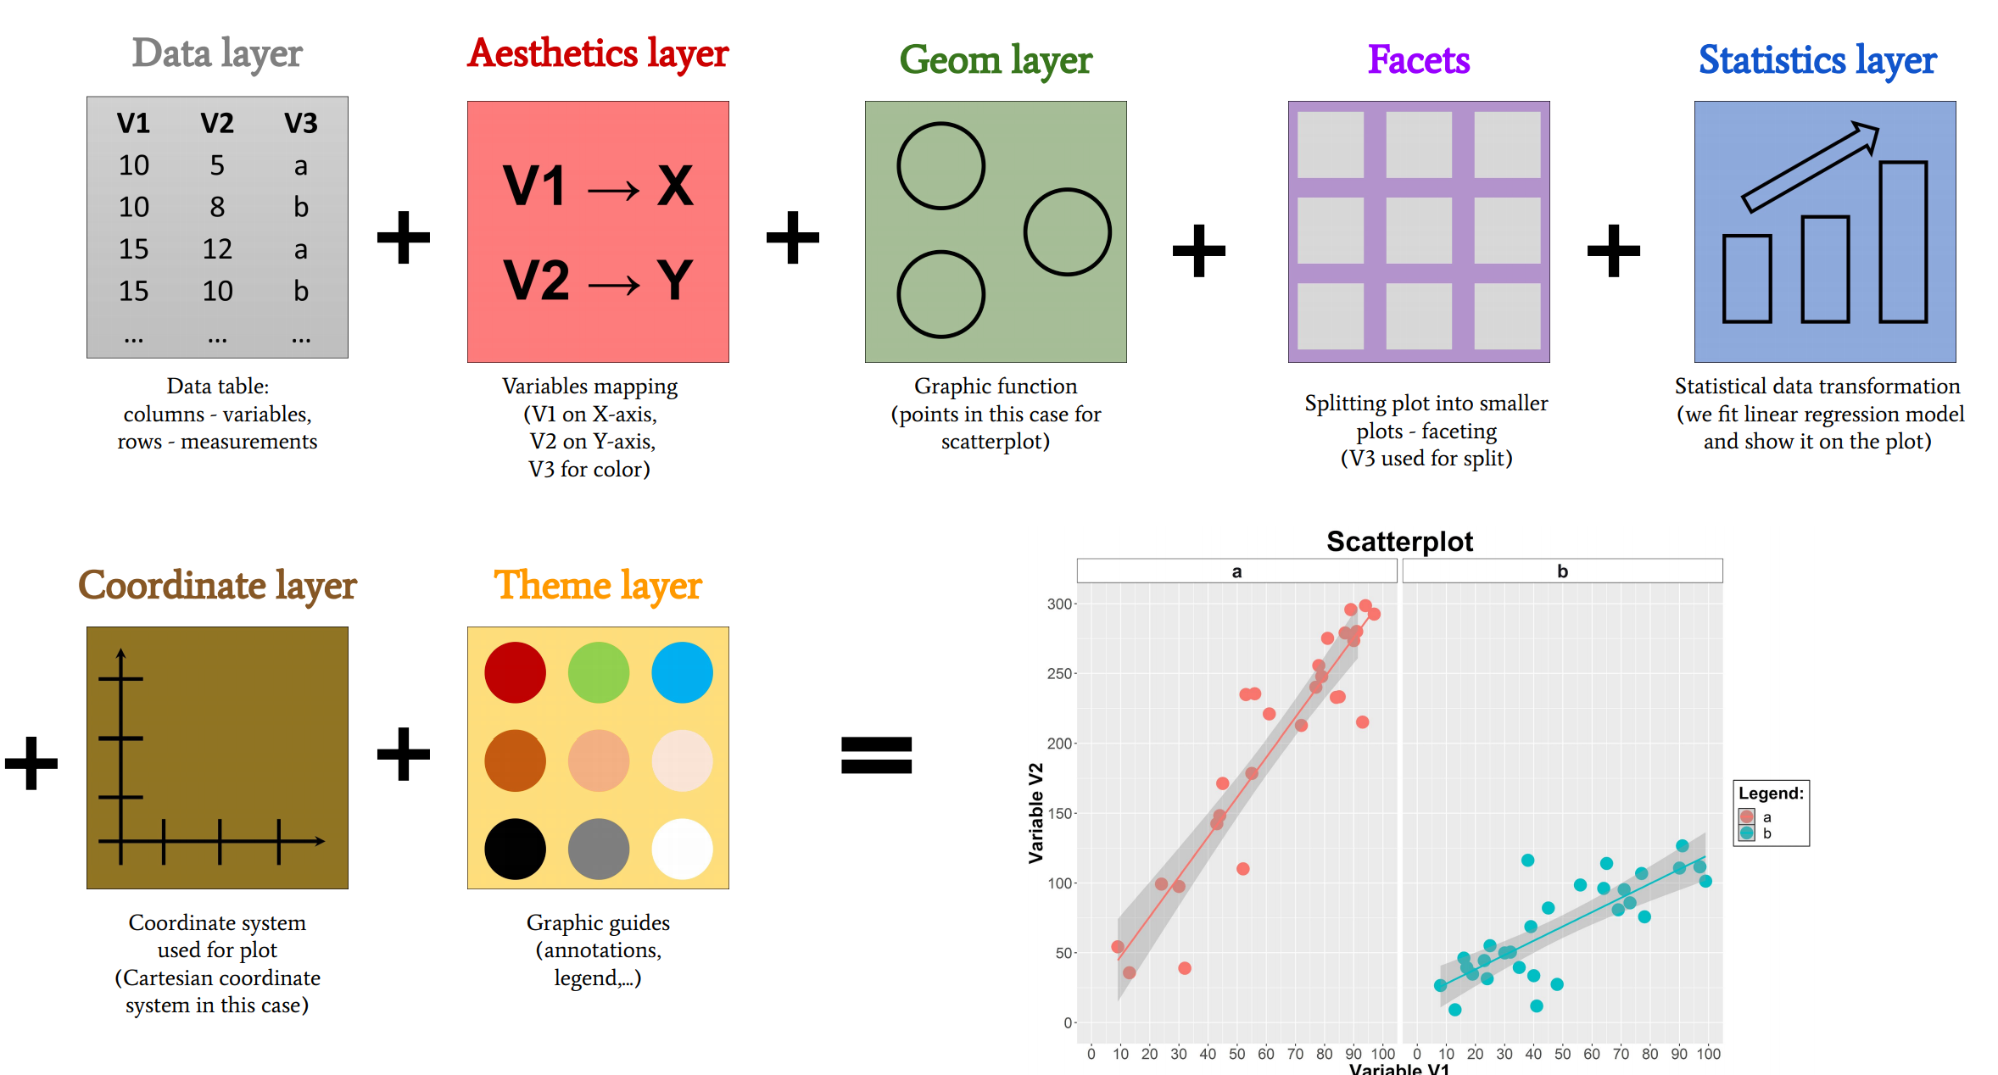
Ggplot2 layers in action

Slide 22
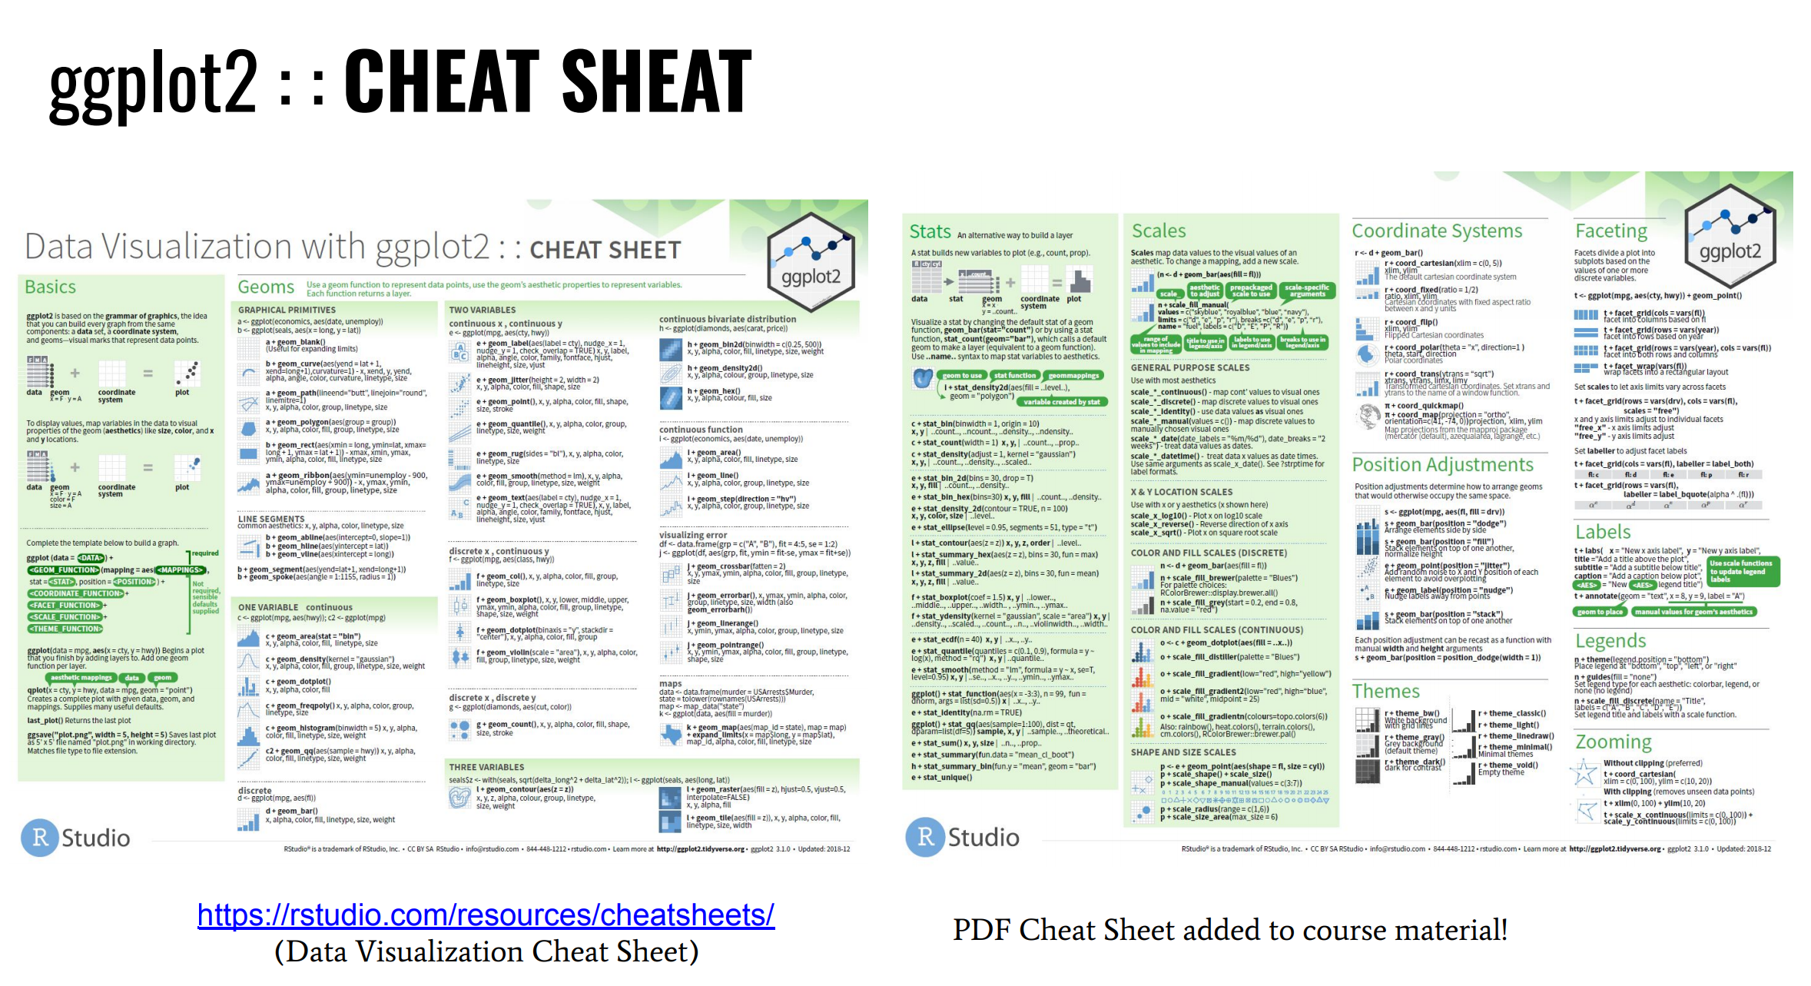

Slide 23
Consider some general rules related to data layer
Data layer - guidelines
● For ggplot figures we normally use raw data.
● Raw data - can tell underlying truth about observed phenomena.
● We provide raw data (dataset) stored as data frame or tibble (inside R environment).
● Data should be organized - tidy data.
● To organize data you normally should do some pre-data wrangling (tidy + transformation).
● Three rules should be considered when we make dataset tidy:
1 Each variable must have its own column!
2 Each observation must have its own row!
3 Each value must have its own cell!

Slide 24
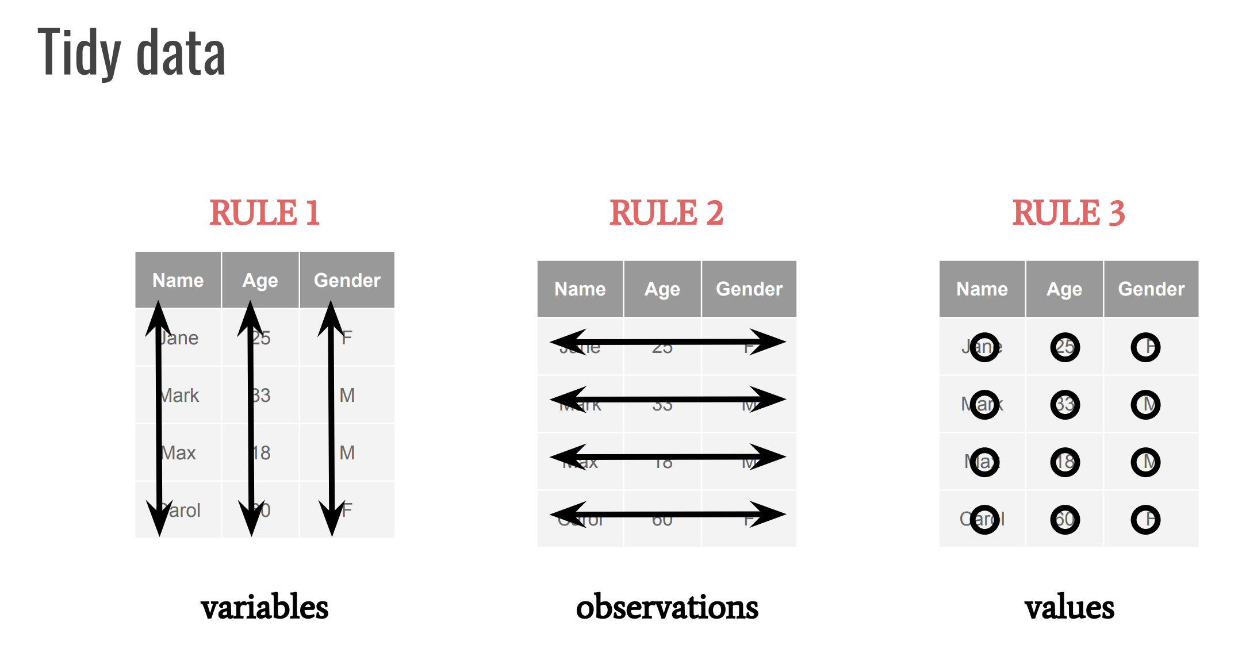

Slide 25
Missing values
Extract missing values
Replace the missing values with zeros
Replace the missing values with the average of the values on the row
Replace the missing values with the lowest value in the data set
Using prediction

Slide 26
Log Transformation of Data
If you intended to use statistical test that assumes the data have a Normal distribution and/or equal variance, you can transform the data or use non-parametric test.

Slide 27
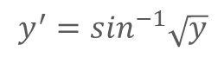
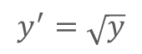
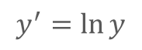
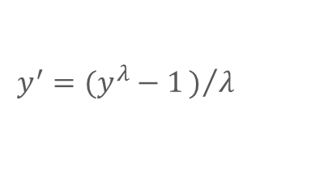
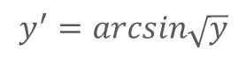
Transformation of Data
Square root transformation
$$y^{′}=\sqrt{y}$$
Angular or arcsine transformation
$$y^{′}=\sin^{−1}\sqrt{y}$$
or
$$y^{′}=arcsin\sqrt{y}$$
Box-Cox transformation
$$y^{′}=(y^{λ}−1)/λ$$
$$y^{′}=\ln{y}$$
(λ=0)

Slide 28
ggplot2 :: DATASETS
Library ggplot2 provides some datasets (already tidy data) we can use for exercises:
● diamonds Prices of round cut diamonds
● economics US economic time series
● faithfuld Density estimate of Old Faithful data
● midwest Midwest demographics
● mpg Car fuel economy data
● msleep Mammals sleep dataset
● presidental Terms of presidents from eisenhower to Obama
● seals Seal movements data
● txhousing Housing sales
● luv_colours Colors in Luv space

Slide 29
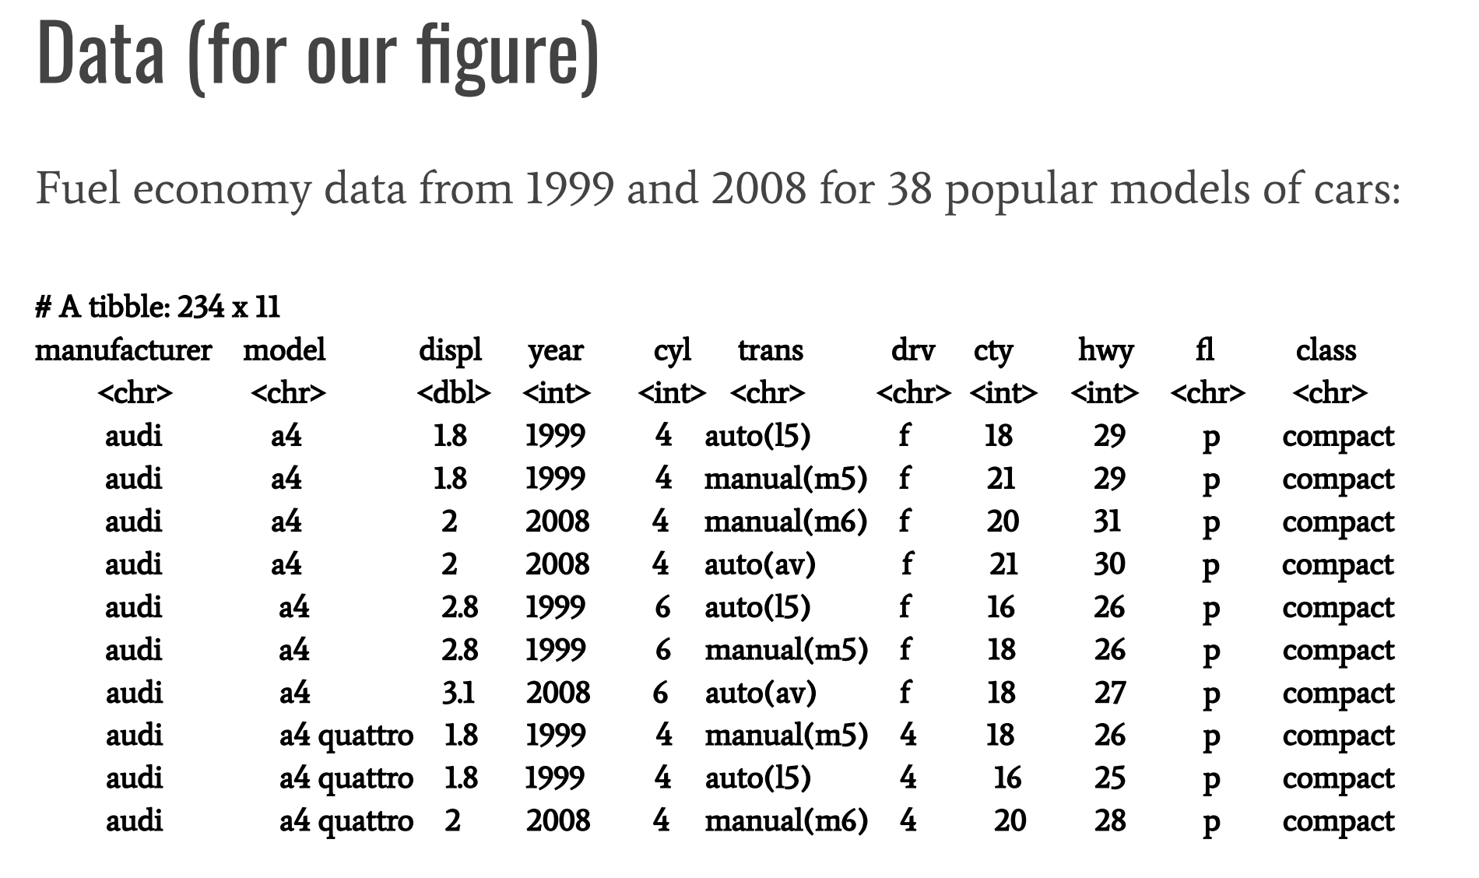
MPG car dataset

Slide 30
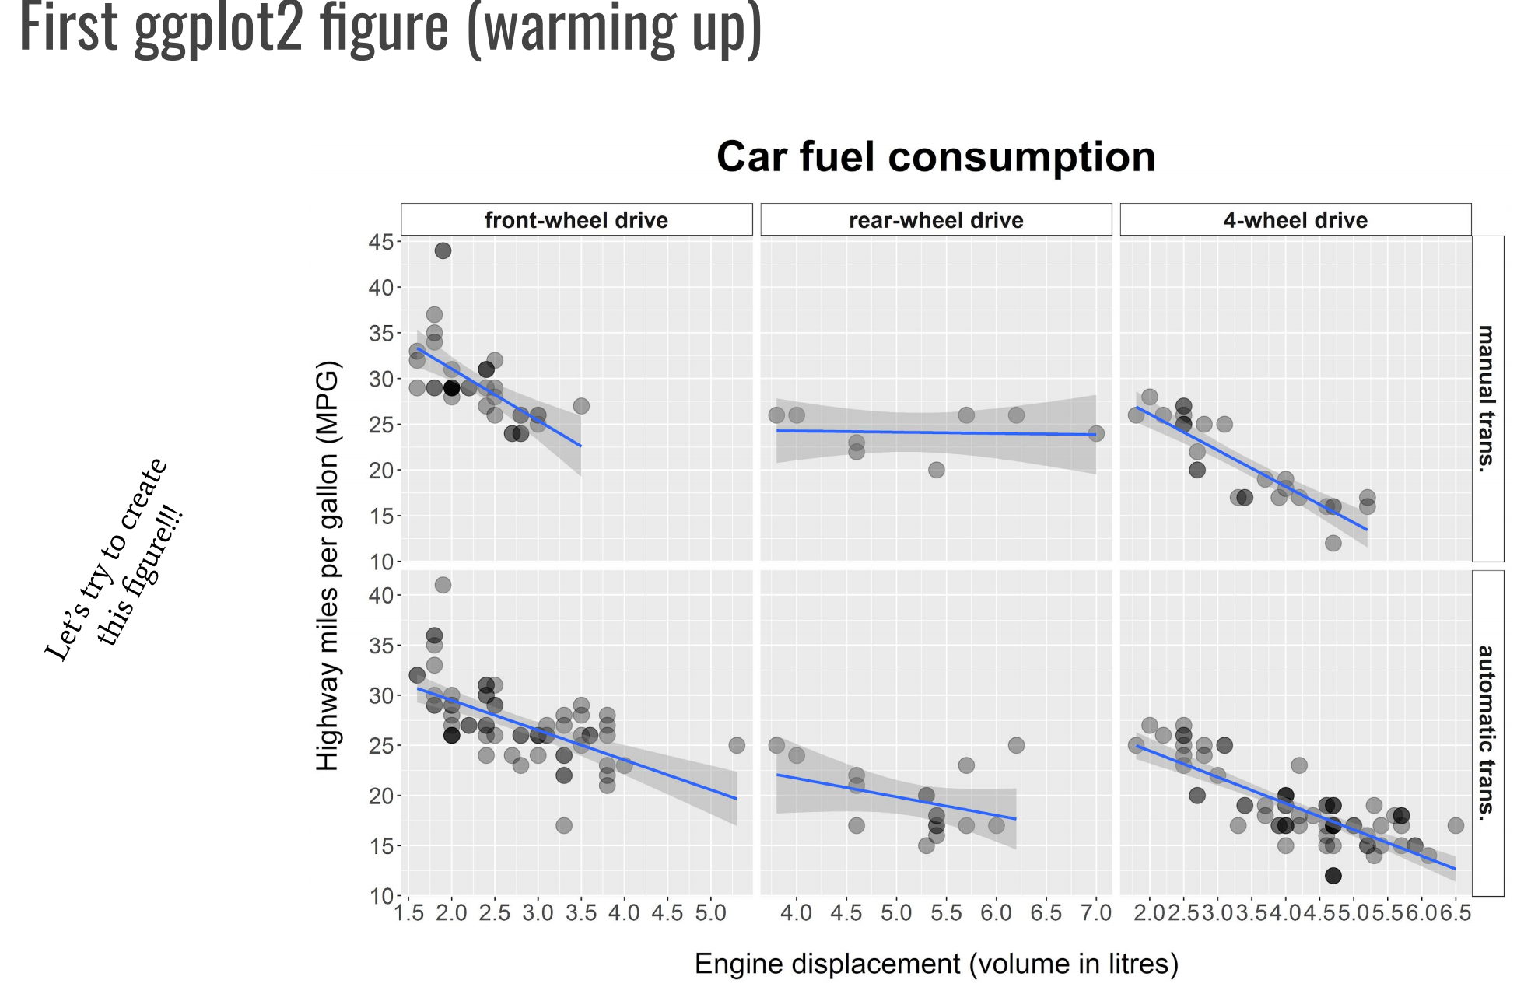

Slide 31
Syntax for the ggplot2
ggplot2 ~ syntax (add data layer)
ggplot(data = <dataset> )
R Script

Slide 32
Aesthetics - Mapping
● Aesthetics means to describe an object on our graphics.
● Without aesthetics we have nothing to show on our graphics.
● Dataset variables are mapped to graphics visual properties with aesthetics mapping.
● It depends what type of statistical graphics we are producing, but usually we map:
○ one variable to be shown on x-axis
○ one variable to be shown on y-axis (in some cases we only need only mapping to only one axis)
○ other variables can be mapped to object color, shape, size, fill color, etc.
● You have endless options with variables mapping inside ggplot2.
● Try to consider one general rule when using aesthetics in plot, less is usually more!

Slide 33
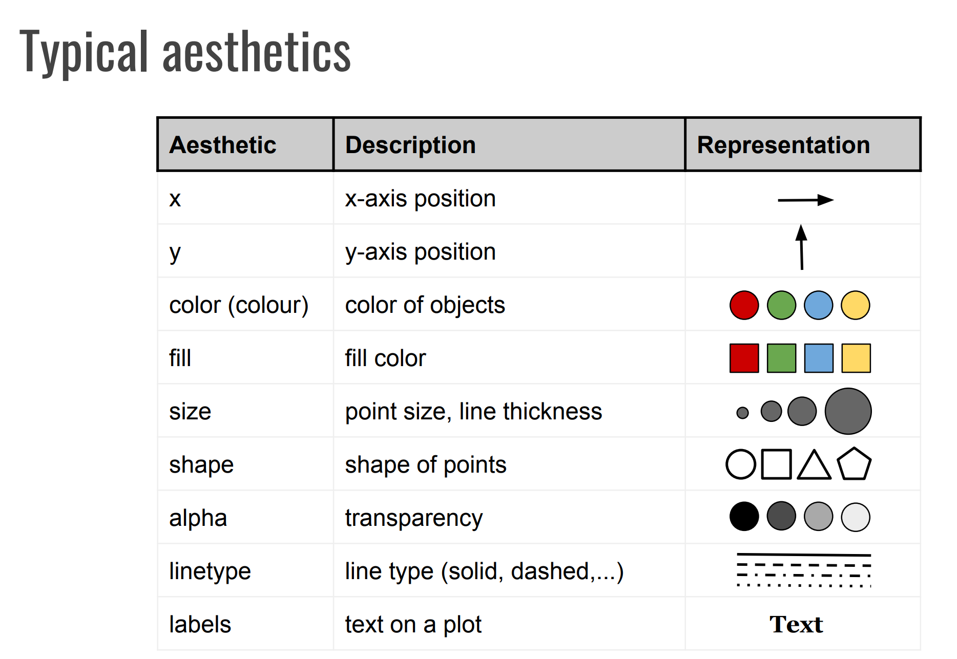
Aesthetics - Mapping

Slide 34
Syntax for Aesthetics
ggplot2 ~ syntax (add aesthetics)
ggplot(data = <dataset>, mapping = aes(x = , y = , ...) )
Function aesthetic wrapper for mapping variables on the plot
R Script

Slide 35
Geometries
Geometry stands for geom function produced by a grapher object.
● Grapher object contains functions to create graphs.
● Functions tell R how to render each observation on given figure.
● With rendering different type of statistical graphics are produced.
● There are many different types of geom functions inside ggplot2.
● Syntax for these functions: geom_(...)

Slide 36
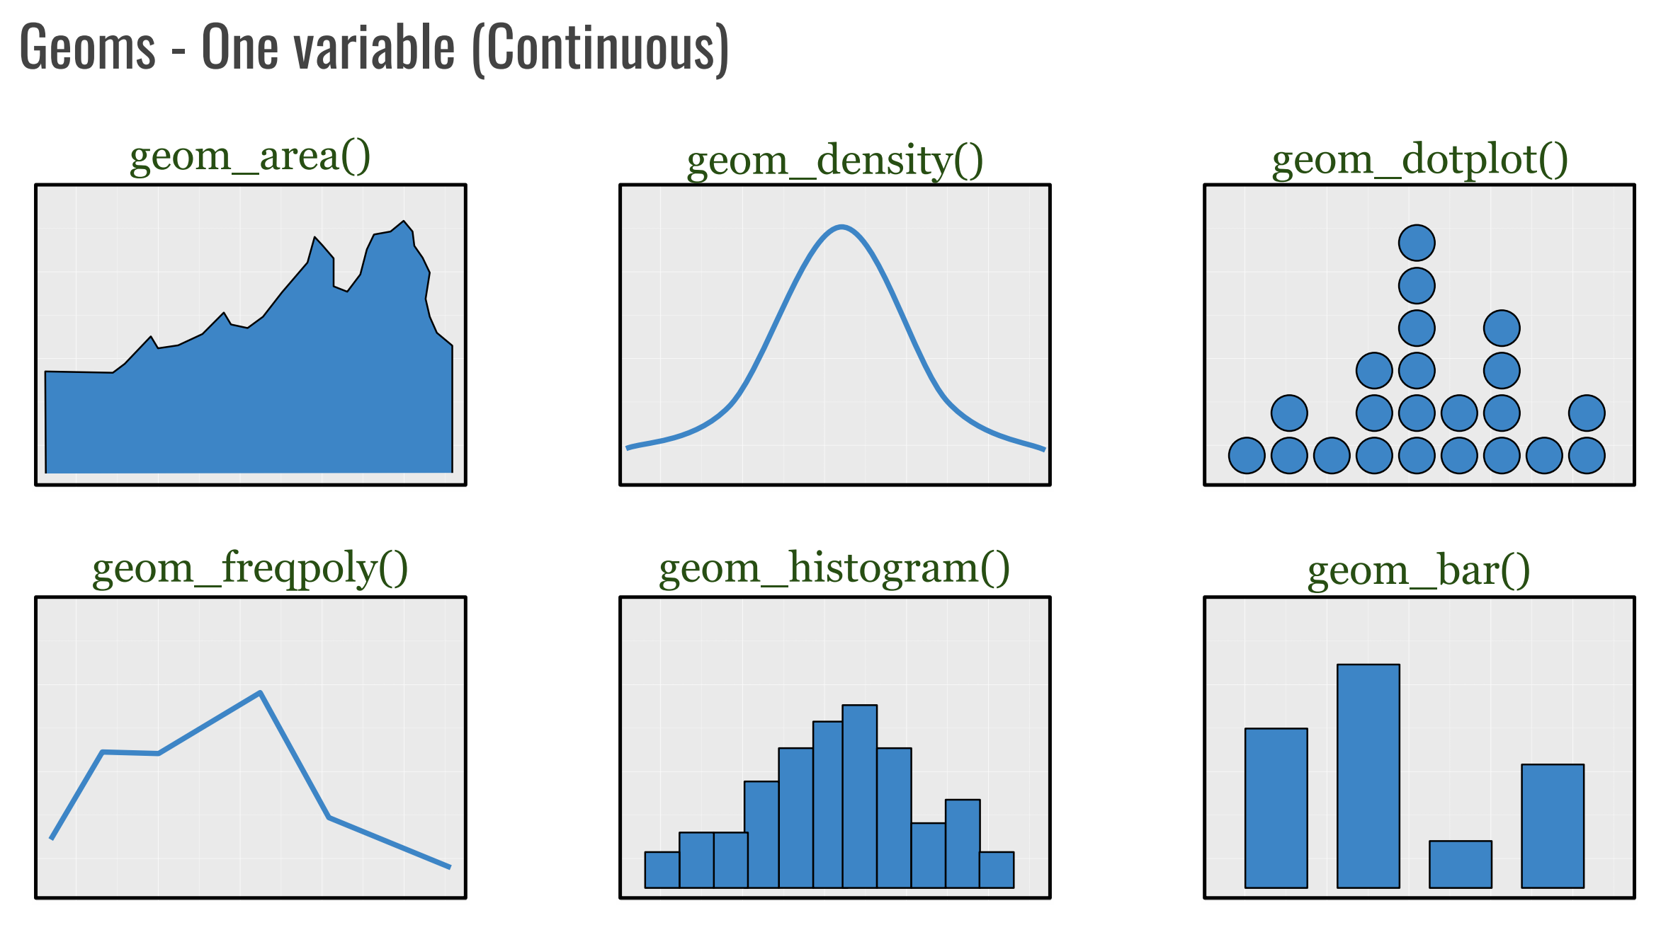
A discrete variable is a variable whose value is obtained by counting. A continuous variable is a variable whose value is obtained by measuring.

Slide 37
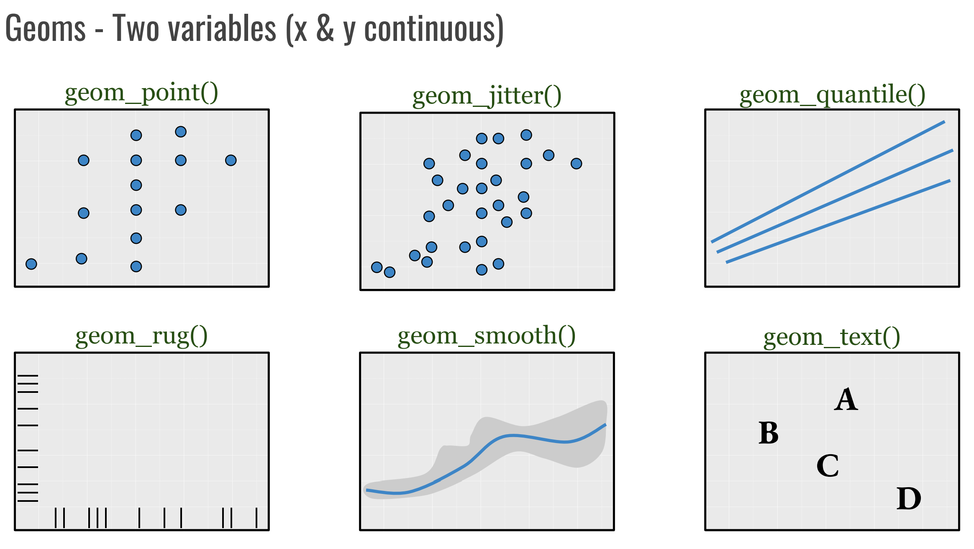

Slide 38
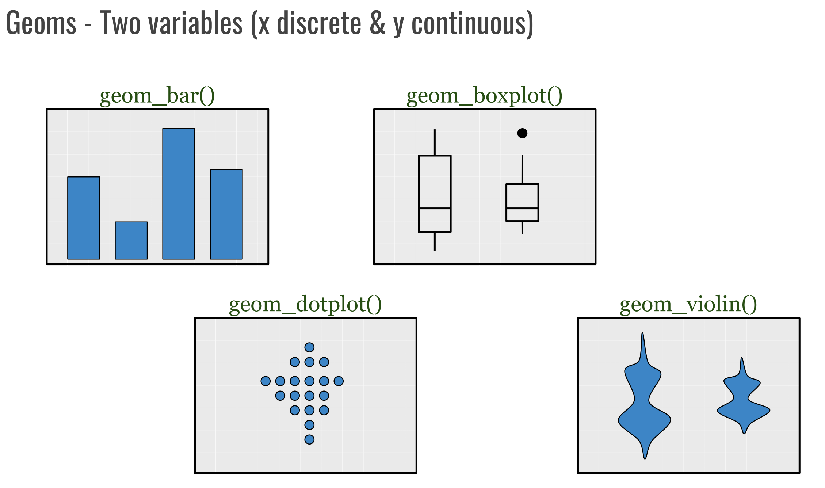

Slide 39
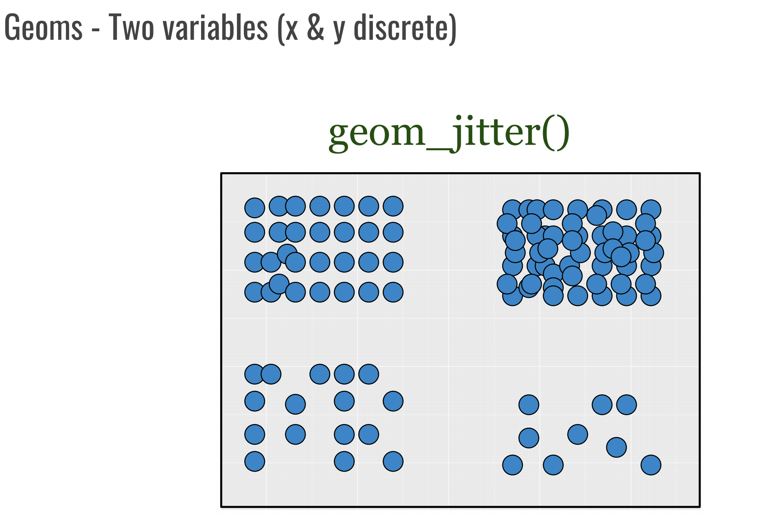

Slide 40
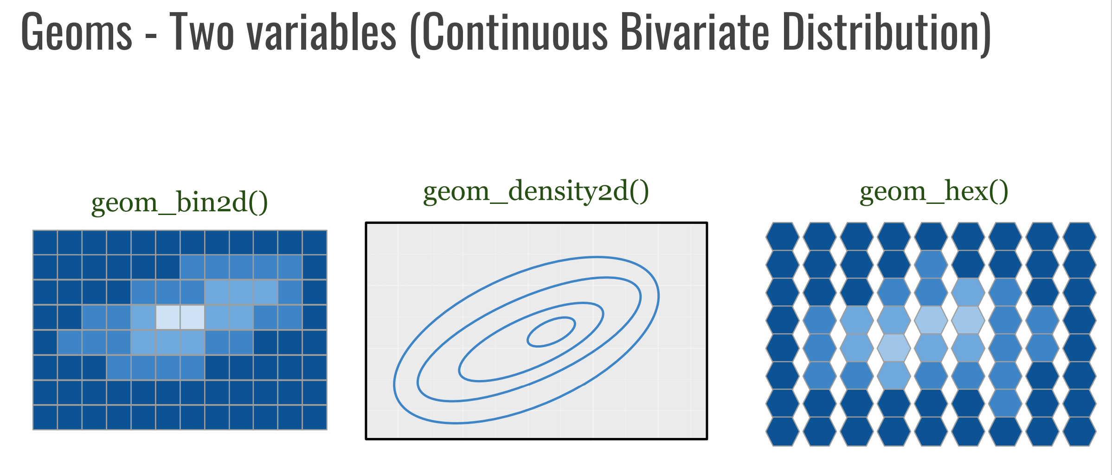

Slide 41
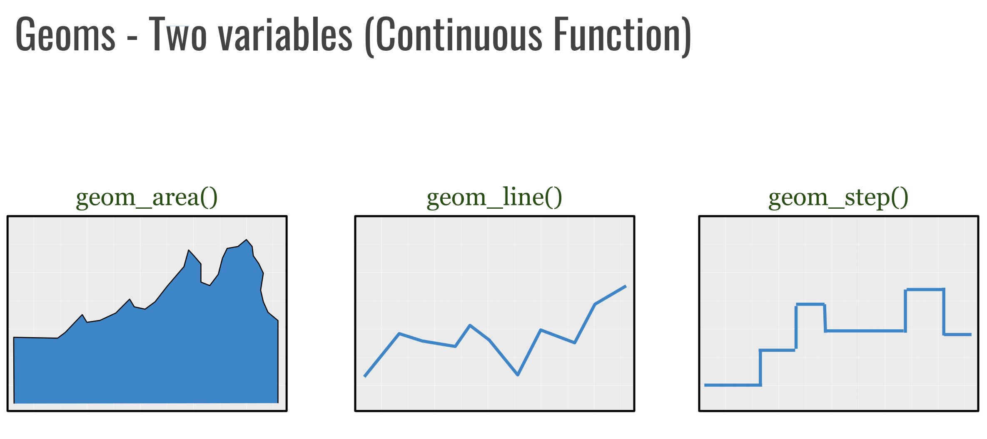

Slide 42
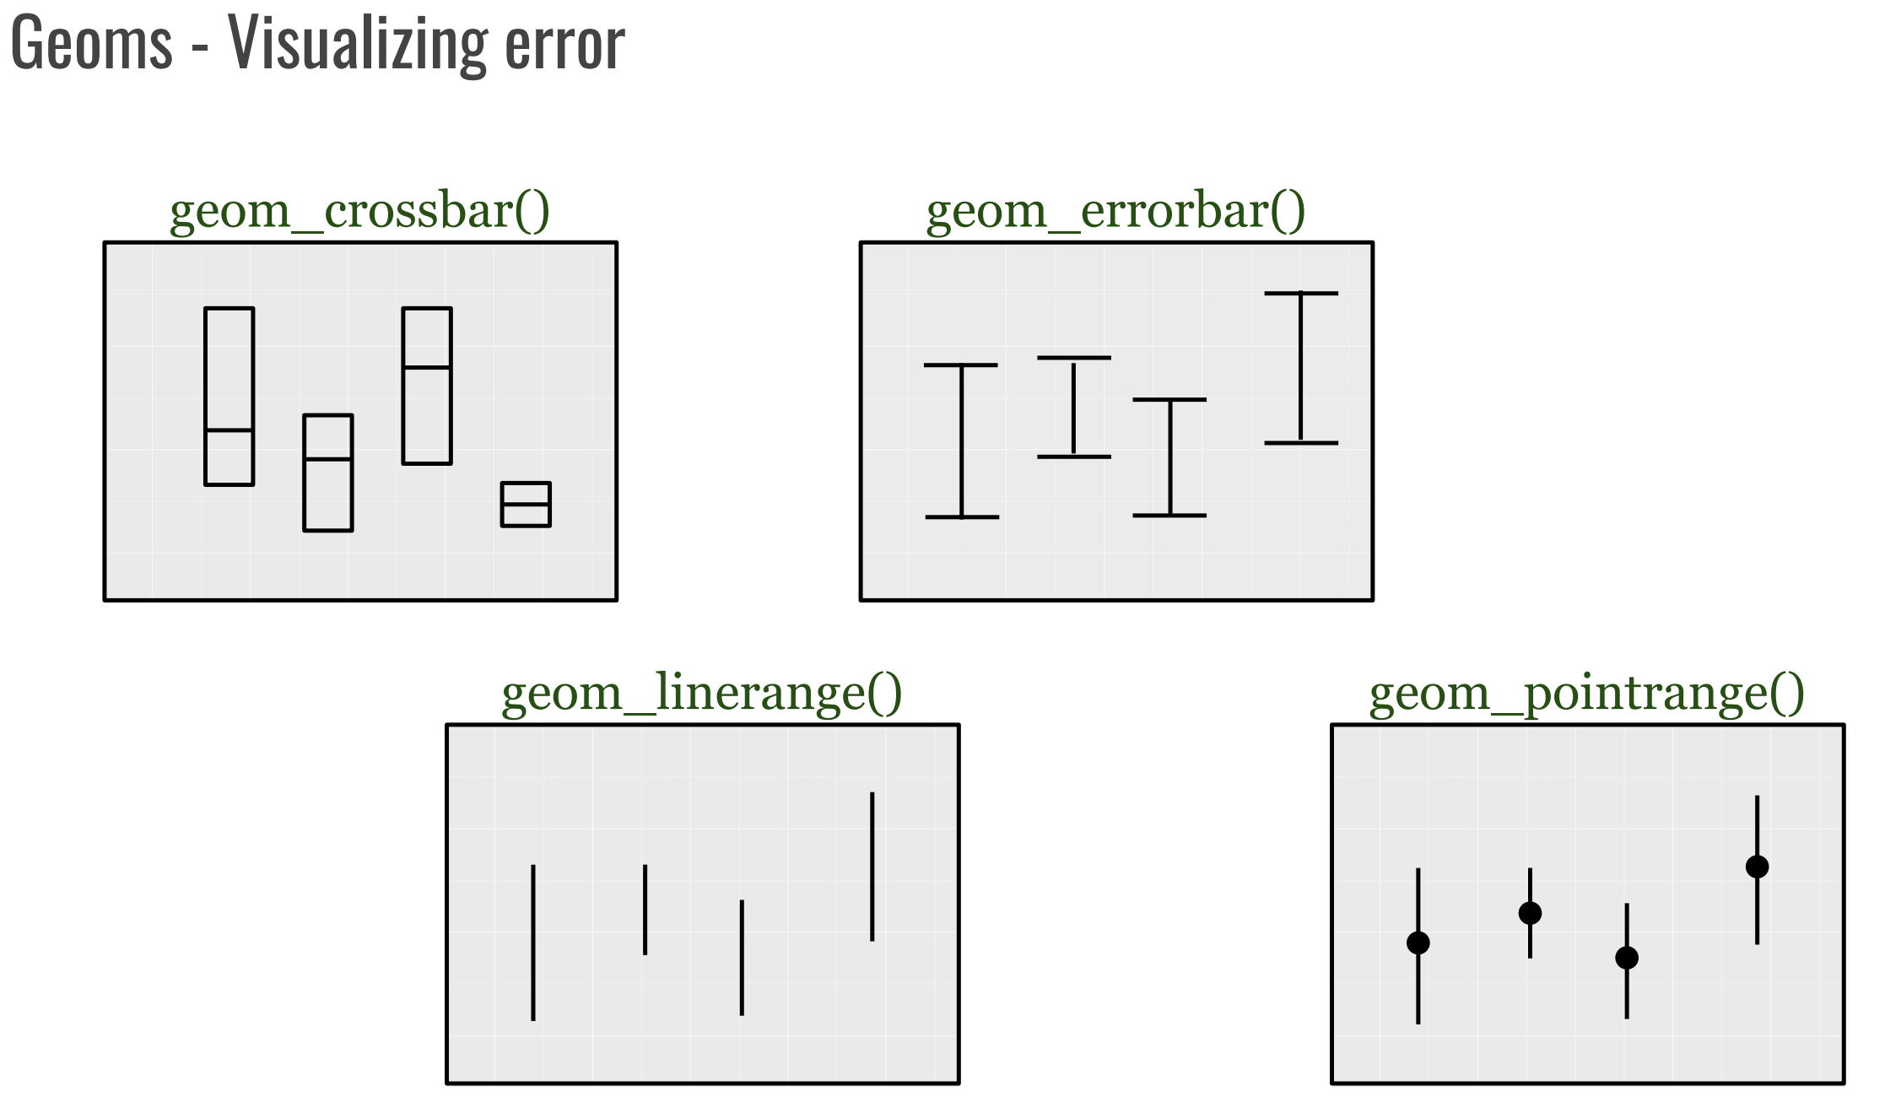

Slide 43
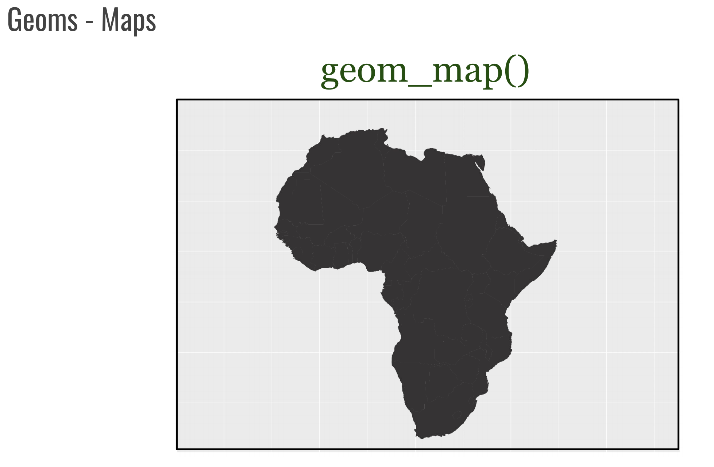

Slide 44
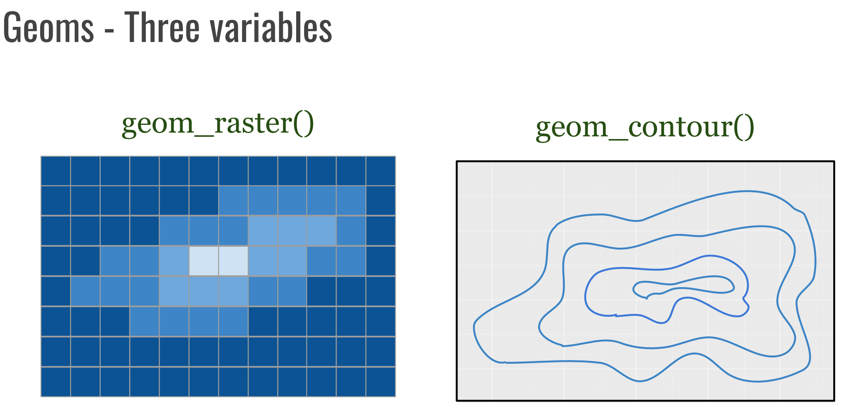

Slide 45
Ggplot2 ~syntax (add geometries)
ggplot(data = <dataset> , mapping = aes(x = <var1>, y =<var2> , ...))
+ geom_<function>(...)
+ operator for adding layers
Geom function attributes
(here you can add aesthetic –mapping)
Name of the selected function
R Script

Slide 46
Facets
● Facets divide a plot into subplots based on the values of one or more discrete (categorical) variables.
● Facet is an object that creates many little graphics that are variations of a single graphic - facets are frames of frames!
● Data is splitted into groups (facets) and data is plotted in their own plots using the same coordinate system!
● We have two options when generating facets:
○ Split plot according to rows and columns: facet_grid()
○ Wrap subplots into columns: facet_wrap()

Slide 47
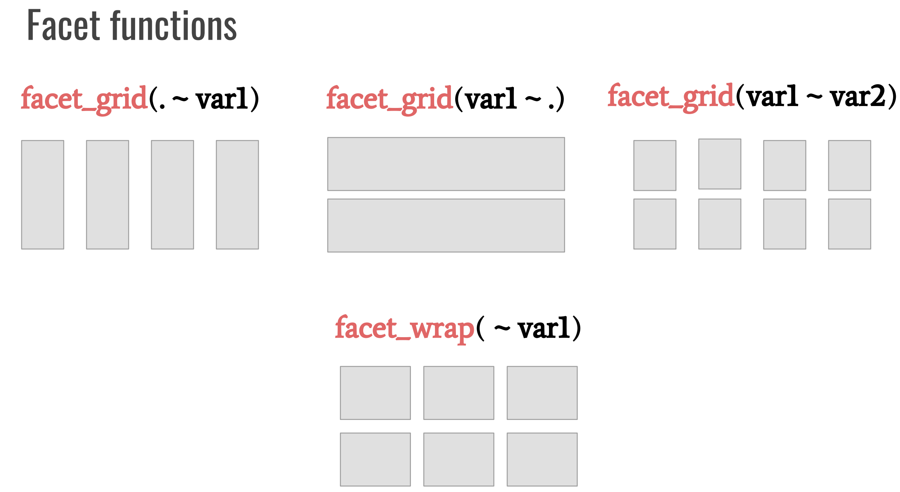

Slide 48
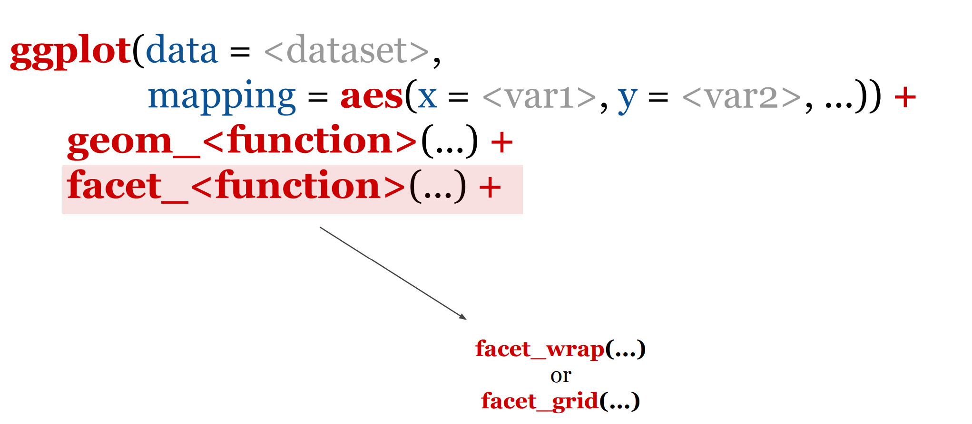
ggplot2 ~ syntax (add facets)
R Script

Slide 49
Statistics
● In graphical system, statistics are methods that alter position of geometries.
● We can represent more than one statistic in one figure.
● Statistic layer represents an alternative way to build a layer, since it is a transformation of the original dataset.
● With statistics we create additional variables (transformed) to map aesthetics to.
● The most important statistical methods available to graphs fall under five-classes:
○ bin (partitions and meshes - for histograms)
○ summary (basic statistics - mean, median, deviation, …)
○ region (interval and region bounds)
○ smooth (regression, smoothing, interpolation, and density estimation)
○ link (methods for computing edges of graphs based on set of nodes or points)

Slide 50
Layer stats
● There are a dozens of statistics layer specified with a stat_function.
● The computed variables (from statistics layer) can be mapped using stat() attribute.
● Some selected stats functions:
○ stat_ecdf() - compute empirical cumulative distribution
○ stat_ellipse() - compute normal confidence ellipses
○ stat_function() - compute function for each x value
○ stat_identity() - leave data as is
○ stat_summary() stat_summary_bin() - summarise y values at unique/binned x values
○ stat_summary_2d() stat_summary_hex() - bin and summaries in 2D
○ stat_unique() - remove duplicates
○ stat_sf_coordinates() - extract coordinates from ‘sf’ objects
○ stat() - calculated aesthetics

Slide 51
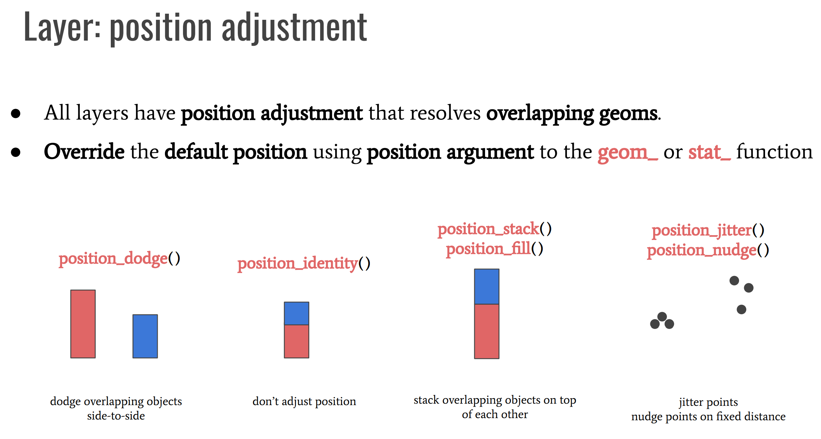

Slide 52
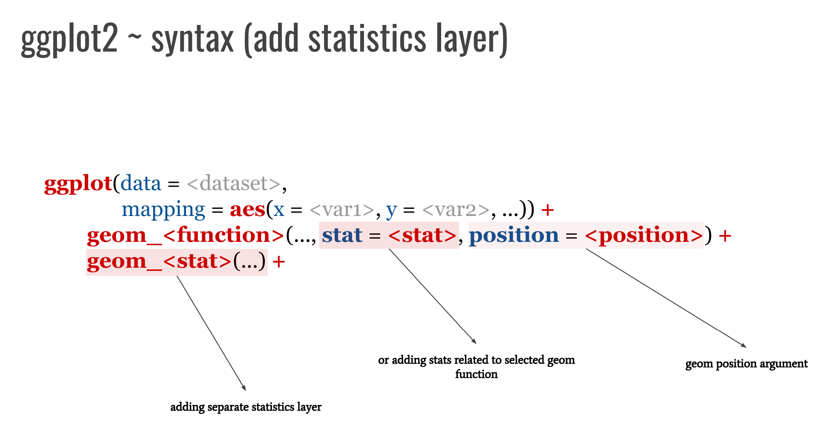
R Script

Slide 53
Coordinates
● Coordinates are sets that locate points in space.
● More generally we see coordinates as schemes for mapping elements of sets to geometric objects.
● The most widely known coordinates are Cartesian coordinates, where point is located on a Cartesian plane by its distance from two intersecting straight lines.
● There are different coordinate systems.
● Why use different systems? One reason is to simplify displaying graphics.
● Coordinate transformations can change some curvilinear graphics to linear.
● ggplot2 provides different coordinate systems

Slide 54
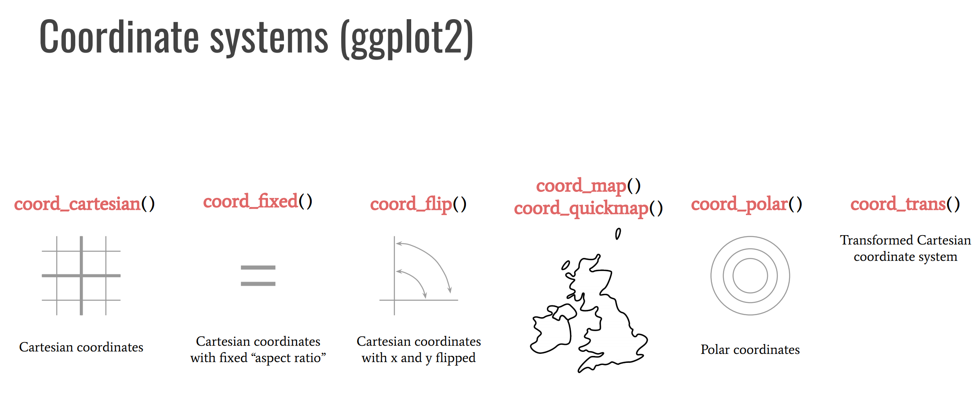

Slide 55
Scales
● Scales control the details of how data values are translated to visual properties.
● We can override the default scales to tweak details like axis labels or legend keys, or to use a completely different translation from data to aesthetic.
● In general, we can use scales for:
○ modifying axis, legend and plot labels,
○ general purpose scales,
○ location scales,
○ color and fill scales,
○ shape scales,
○ size scales and more…

Slide 56
General purpose scales
Use with any aesthetic:
○ alpha, color,
○ fill,
○ linetype,
○ shape, size
scale_*_continous() - map continuous values to visual values scale_*_discrete() - map discrete values to visual values scale_*_identity() - use data values as visual values
scale_*_manual() - map discrete values to manually chosen visual values

Slide 57
X and Y location scales
● Use with x or y aesthetic (x selected below!)
scale_x_date() - treat x values as dates
scale_x_datetime() - treat x values as date times scale_x_log10() - plot x on log10 scale
scale_x_reverse() - reverse direction of x axis
scale_x_sqrt() - plot x on square root scale

Slide 58
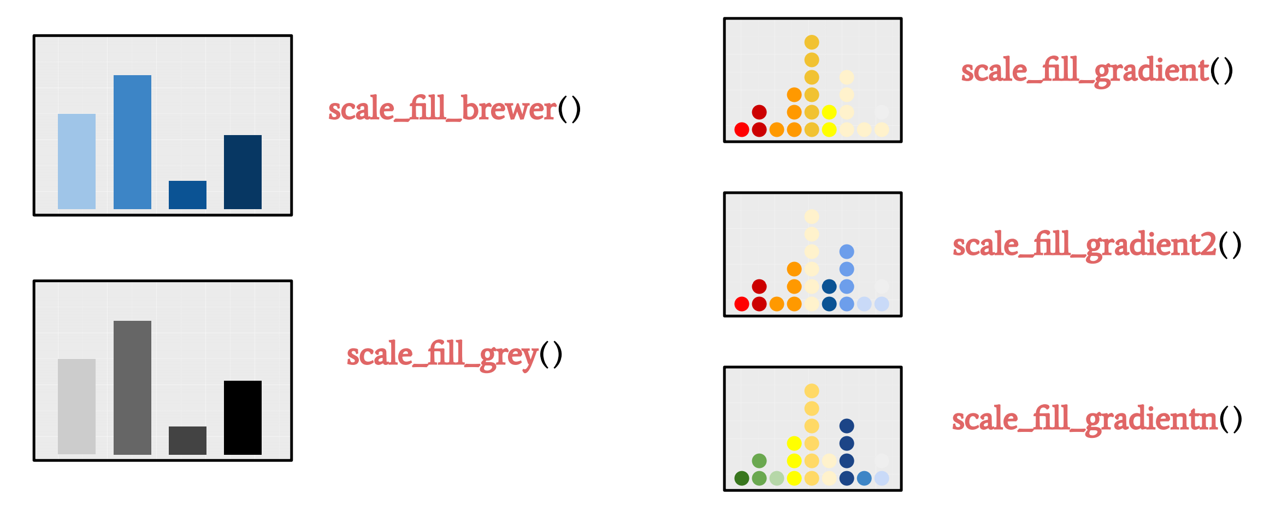
Color and fill scales
Discrete
Continuous

Slide 59
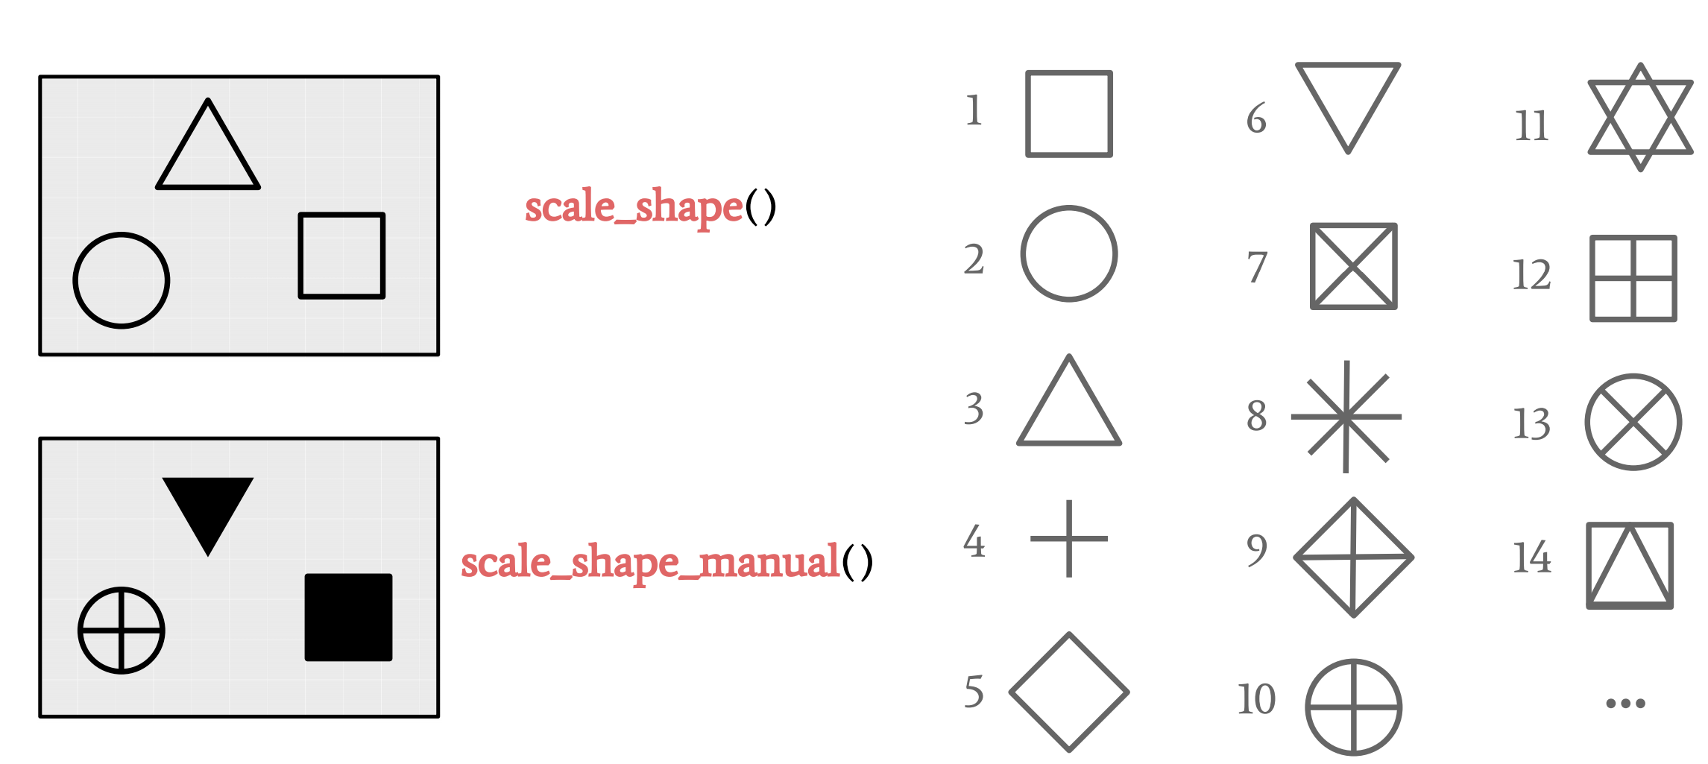
Shape scales
Manual shape values

Slide 60
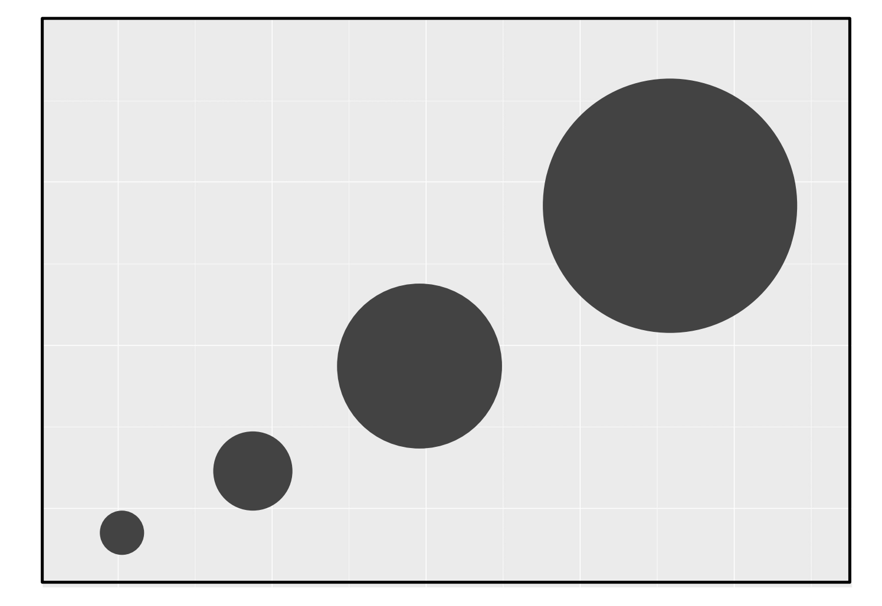
Size scales
scale_size_area()

Slide 61
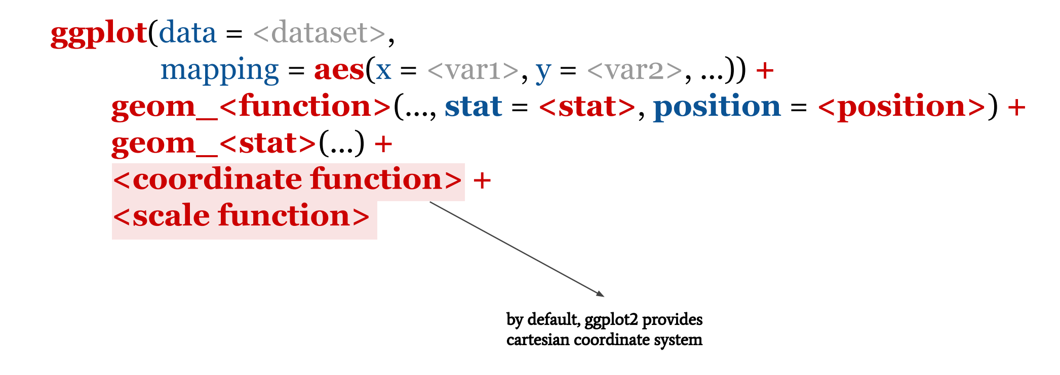
Ggplot2 ~ syntax (add coordinate layer & scales)

Slide 62
Theme
● Theme is used for controlling all non-data elements on the plot.
● ggplot2 provides defaults for theme layer (you can leave it as is).
● You can override default theme, for example with:
○ theme_bw() - with black and white theme
○ theme() - function for tweaking individual theme settings
○ element_ - functions for altering theme settings
○ theme_set() - for modifying the active theme, affecting all future plots

Slide 63
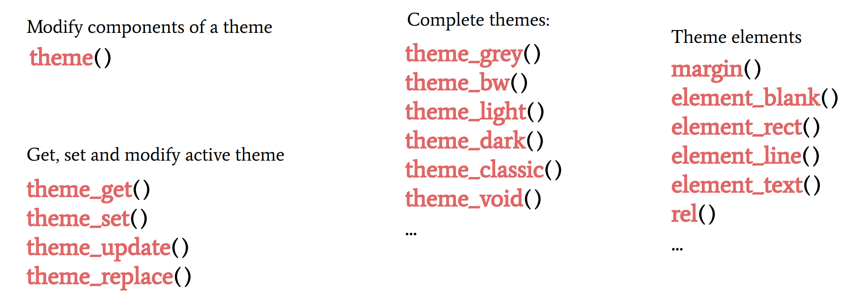
Theme guidelines

Slide 64
For more learning, please check these sites:
https://community.rstudio.com/
https://stackoverflow.com/questions/tagged/ggplot2?sort=frequent&pageSize=50
https://www.tidyverse.org/packages/
http://rstudio-pubs-static.s3.amazonaws.com/3355_d3f08cb2f71f44f2bbec8b52f0e5b5e7.html

